Slide 1

Angular
Dilip Kumar
Assistant Professor
Computer Science & Engineering

Slide 2
Component
The Component is the main building block of an Angular Application.
The Component contains the data & user interaction logic that defines how the View looks and behaves.
A view in Angular refers to a template (HTML).
The Angular Components are plain JavaScript classes and defined using @Component Decorator.
This Decorator provides the component with the View to display & Metadata about the Component

Slide 3
Component
Components are building block of Angular application. The main job of Angular Component is to generate a section of web page called view. Every component will have an associated template and it will be used to generate views.

Slide 4
Component
The Component is responsible to provide the data to the view.
The Angular does this by using data binding to get the data from the Component to the View. This is done using the special HTML markup knows as the Angular Template Syntax.
The Component can also get notified when the View Changes.
The Angular applications will have lots of components. Each component handles a small part of UI. These components work together to produce the complete user interface of the application

Slide 5
Adding new Component
ng generate component ComponentName
or
ng g c componentName
Note: Type Script file can include an HTML template, component class, and component metadata.

Slide 6
Component Naming Convention
All the component files in Angular should follow the following format:
<component-name>.component.<file-type>
A component file should include .component in name prefixed with the component name and followed by file type.
For example: A Type Script file for our dk component is named dk.component.ts.
As noticed, all the files of dk component are having the same naming conventions.

Slide 7
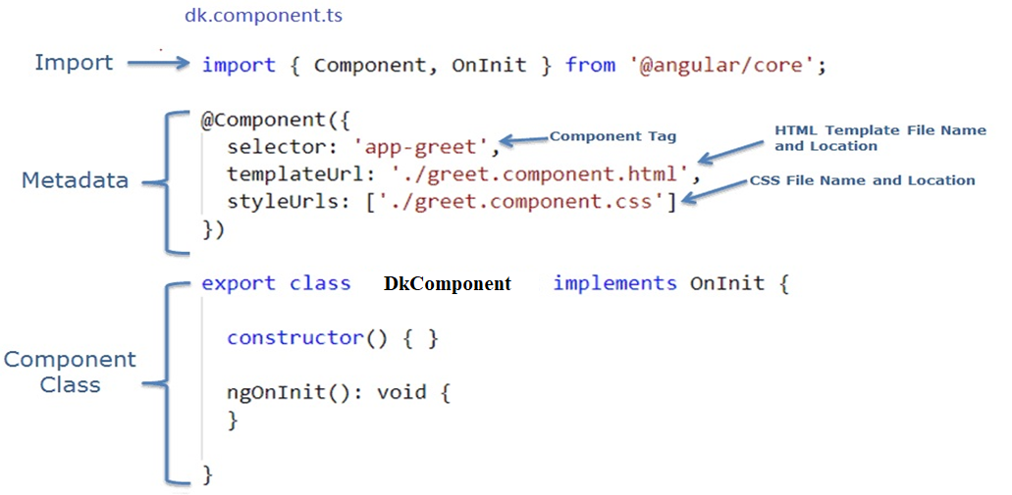
Component

Slide 8
Component
Component Class: GreetComponent is the component class. It contains properties and methods to interact with the view through an Angular API. It implements the OnInit interface, which is a lifecycle hook.
Component Metadata: The @Component is a decorator used to specify the metadata for the component class defined immediately below it. It is a function and can include different configs for the component. It instructs Angular where to get required files for the component, create and render component. All Angular components must have @Component decorator above the component class.
The import statement gets the required feature from the Angular or other libraries. Import allows us to use exported members from external modules. For example, @Component decorator and OnInit interface are contained in @angular/core library. So, we can use them after importing it.

Slide 9
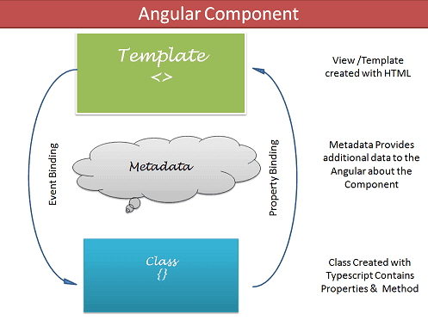
Component
The Components consists of three main building blocks
Template
Class
MetaData
Building blocks of the Angular Components

Slide 10
Building blocks of the Angular Components
Template (View)
The template defines the layout and content of the View. Without the template, there is nothing for Angular to render to the DOM.
The Templates are nothing but HTML codes along with the Angular specific special HTML markups ( knows as the Angular Template Syntax).
You can add Angular directives , Angular Pipes & Other Angular Components on the template.
The data to Template comes from the Component, which in turn gets it from a Angular Service. Using the data binding techniques, we can keep the Template in sync with the Component. The templates can use the Event Binding or two way data binding to notify the component, when user changes something on the View.

Slide 11
Building blocks of the Angular Components
There are two ways you can specify the Template in Angular.
Defining the Template Inline
Provide an external Template

Slide 12
Building blocks of the Angular Components
Class: The Class provides the data & logic to the View. It contains the JavaScript code associated with Template (View). We use TypeScript to create the class, but you can also use JavaScript directly in the class.
Class Contains the Properties & Methods. The Properties of a class can be bind to the view using Data Binding.
The simple Angular Class
export class AppComponent
{
title : string ="app"
}
Note: By convention we prefix the Component class with Component so as to easily identify them.

Slide 13
Building blocks of the Angular Components
Metadata: Metadata Provides additional information about the component to the Angular. Angular uses this information to process the class. We use the @Component decorator to provide the Metadata to the Component.
@Component decorator
A decorator is a function that adds metadata to class, its methods & to its properties. The Components are defined with a @Component class decorator.
When Angular sees a class with @Component decorator, it treats the class as Component.
A Decorator is always prefixed with @. We must place the Decorator immediately before the class definition. We can also build our own decorators. The decorators are Similar to attributes in C#

Slide 14
Component
In component class, selector can specify
app-test use as tag
.app-test use as class
[app-test] use as attribute

Slide 15
Important Component metadata properties
Selector Selector specifies the simple CSS selector. The Angular looks for the CSS selector in the template and renders the component there.
Providers The Providers are the Angular Services, that our component going to use. The Services provide service to the Components or to the other Services.
Directives The directives that this component going to use are listed here.
Styles/styleUrls The CSS styles or style sheets, that this component needs. Here we can use either external stylesheet (using styleUrls) or inline styles (using Styles). The styles used here are specific to the component.
template/templateUrl The HTML template that defines our View. It tells Angular how to render the Component’s view. The templates can be inline (using a template) or we can use an external template (using a templateUrl). The Component can have only one template. You can either use inline template or external template and not both.

Slide 16
Component Interaction
added component(test component) is nested inside in app component.
app component is parent component and test is child component.
these all work independently but we going to come across a scenario where component is need to communicate with each other.
parent component might send to child or vice versa.
To communicate or interact using @input and @output decorators.
@input decorator child can accept data from parent.
@ouput decorator child can out data to parent.

Slide 17
Component Interaction
Ex: Send the name from app component(Parent) to test(Child) component
=> Open app.component.ts & add a property
public name="Dilip";
=> in app.component.html
<app-test [parentData]="name"></app-test>
=> in test.component.ts, declare the same property as sending
@input()
public parentData;
Note: import Input from angularcli
In the template
<h2>{{parentData}}</h2>
To specify alias
@Input('parentData') public name;

Slide 18
Component Interaction
Child to parent
@Ouput() public childEvent=new EventEmitter();
Note: import {Input,Output,EventEmitter} from '@angular/core';
=>
<button (click)="fireEvent()">Send Event</button>

Slide 19
Thankyou

